Slide 1


Sponsored Programs Administration Resource & Knowledge Series
AWARD CLOSE-OUT
Presented by:
Justo Torres & Jill Aller

Slide 2
General Business
CERTIFICATE CEREMONY
August 29th
AWARD CLOSE-OUT

Slide 3
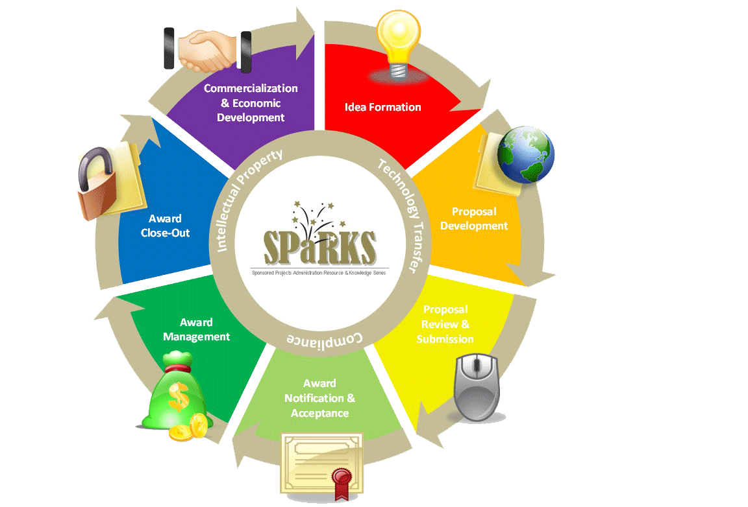
Exploring Research Administration from Concept to Commercialization

Slide 4
CLOSEOUTS!
Take a minute and write down your answers…
What do you know about closeouts?
What do you want to know about closeouts?
What’s a closeout?

Slide 5
Exploring Research Administration from Concept to Commercialization
CLOSE-OUT OVERVIEW
OMB A-110
OMB A-133
Reporting Responsibilities
Award Document Cues
Justo Torres & Jill Aller

Slide 6
CLOSE-OUT OVERVIEW
Close-out Requirements
(as defined by OMB A-110, Section D)
All reports due within 90 days of project end
  D.71.(a) says that sponsor may approve extension
All obligations liquidated within 90 days of project end
Sponsor will make prompt payments
Recipient will promptly refund unobligated cash
  OMB A-129 governs delinquent debts
Sponsor shall make upward/downward adjustments after close-out docs are received
Recipient shall account for real and personal property
Sponsor may recover unallowable costs after an audit
AWARD CLOSE-OUT

Slide 7
CLOSE-OUT OVERVIEW
Responsible Parties
Technical
(PI)
Administrative
(ORC)
Financial
(F&A, ORC)
AWARD CLOSE-OUT

Slide 8
CLOSE-OUT OVERVIEW
Administrative | Financial
Deliverables/Progress Reports? - PI | Personnel still being paid from project?
Intellectual Property (Patents, Copyrights, etc.)? | Encumbrances?
Equipment? | Charges after project’s end date?
Subcontracts? Close them too. | Outstanding accounts payable invoices?
IRB/IACUC approval on file? | Is project over or underspent?
Agency Reports to submit? | Indirect/Overhead charged correctly?
 | All revenue received?
 | Balance to be transferred?
AWARD CLOSE-OUT

Slide 9
Exploring Research Administration from Concept to Commercialization
PRE-CLOSEOUT CONSIDERATIONS
Reporting Requirements
Invoice & Payment
Expenditure Review
Budget & Cost Transfers
Obligations
No Cost Extensions
Justo Torres & Jill Aller

Slide 10
PRE-CLOSEOUT CONSIDERATIONS
90 Days before a project ends
Technical Reports and Deliverables
Expenditure and Revenue
Invoicing
Equipment Vesting
Plans for Personnel
Equipment Vesting
To Extend or Not to Extend…
Other Recurring Charges
THINGS TO REVIEW
AWARD CLOSE-OUT

Slide 11
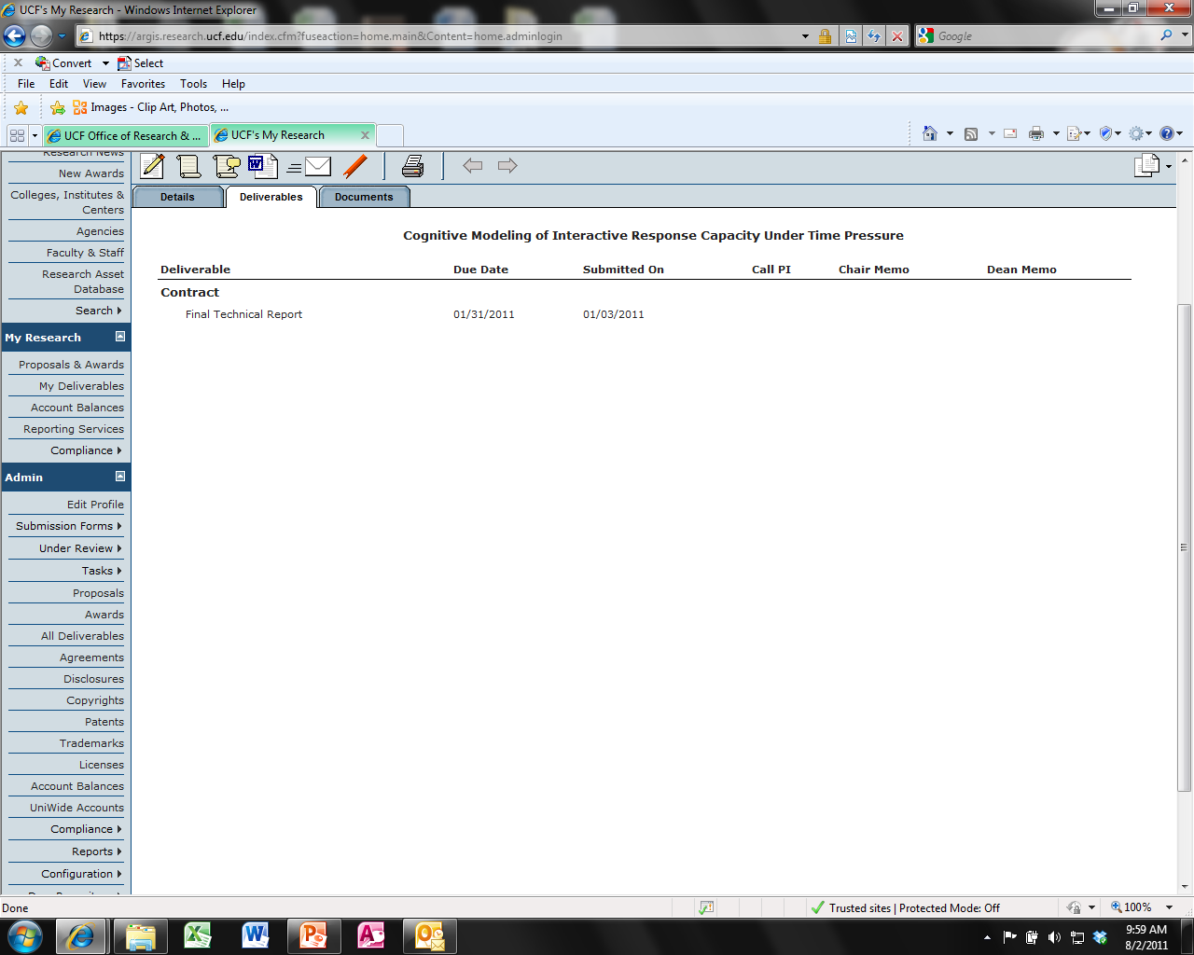
PRE-CLOSEOUT CONSIDERATIONS
Reporting Requirements – What does ARGIS say?
AWARD CLOSE-OUT

Slide 12
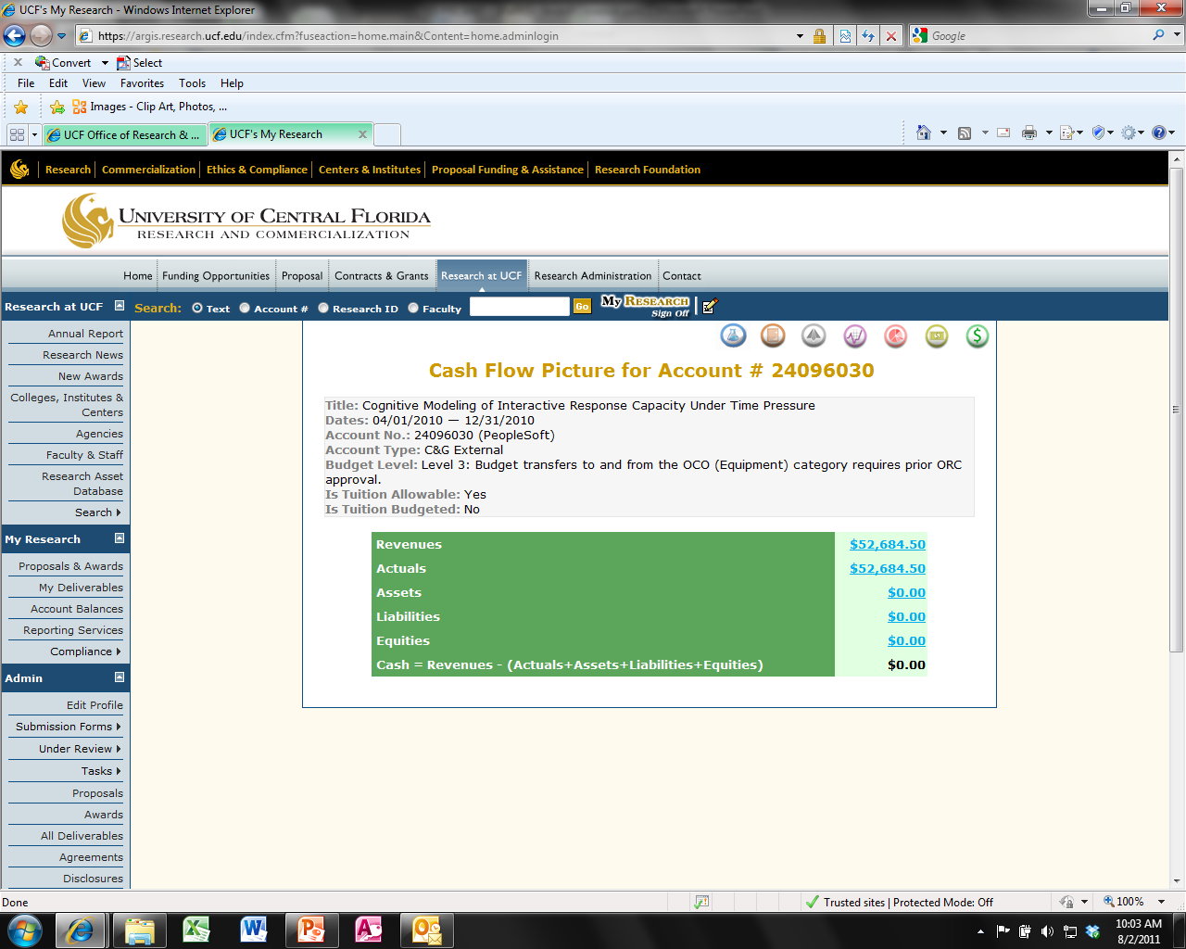
PRE-CLOSEOUT CONSIDERATIONS
Invoice and Payment
AWARD CLOSE-OUT

Slide 13

PRE-CLOSEOUT CONSIDERATIONS
Expenditure Review
Expenditures should be monitored at all times, but…
Corrections or adjustments may be required
Are All Costs Reasonable, Allowable, Allocable, and Appropriate?
Is the Project Over or Under Spent?
Are There any Costs That Do Not Belong?
Do I have More or Less Revenue than Expected?
AWARD CLOSE-OUT

Slide 14
PRE-CLOSEOUT CONSIDERATIONS
Budget Transfers
  Moving available budget from one line item to another within one project account.
AWARD CLOSE-OUT

Slide 15
PRE-CLOSEOUT CONSIDERATIONS
Cost Transfers
  Moving expenditures on or off of a project onto a project or dept.
Project A
Project B
AWARD CLOSE-OUT

Slide 16



PRE-CLOSEOUT CONSIDERATIONS
Outstanding Obligations
Actually put that plan into effect
Every Time your phone rings, think about the projects that are ending
Speaking of the phone…are the callers asking about the status of their payment?
Cost Share…You were serious about that?
Did I ever get reimbursed for that trip?
Time to Be Done
Develop a Transfer plan for Project personnel
AWARD CLOSE-OUT

Slide 17
PRE-CLOSEOUT CONSIDERATIONS
No-Cost Extensions
To extend or Not to extend…
Deliverables missing
Additional data needed
Additional Time needed for final technical report
Subcontractor requesting additional time
REQUEST/NOTIFY NO-COST EXTENSION
Deliverables complete
Subcontractor’s work is complete
Final technical report in process for completion
Balance Remains
PROCEED TO CLOSEOUT
AWARD CLOSE-OUT

Slide 18
PRE-CLOSEOUT CONSIDERATIONS
No Cost Extensions
Check w/ PI if more time is needed to complete project work
If more time is needed, request a NCE from sponsor
  (the sooner the better, not once the award has expired!)
NCE should be same form and format as original award
For NSF-funded projects:
  Grantees may authorize a one-time extension up to 12 months
  Must notify NSF within 10 days of award end date
AWARD CLOSE-OUT

Slide 19
Exploring Research Administration from Concept to Commercialization
CLOSE-OUT PROCESS
Administrative
Financial
Justo Torres & Jill Aller

Slide 20
CLOSE-OUT OVERVIEW
Administrative | Financial
Deliverables/Progress Reports? - PI | Personnel being paid?
Intellectual Property (Patents, Copyrights, etc.)? | Encumbrances?
Equipment? | Charges after project’s end date?
Subcontracts? Close them too. | Outstanding accounts payable invoices?
IRB/IACUC approval on file? | Is project over or underspent?
Agency Reports to submit? | Indirect/Overhead charged correctly?
 | All revenue received?
 | Balance to be transferred?
AWARD CLOSE-OUT

Slide 21

CLOSE-OUT PROCESS
Administrative - Deliverables
Technical Review and Certification
Ensures that all technical work has been performed as specified in the award document and is acceptable to the sponsor
Were all deliverables submitted?
Final Report
SF 298
DD 254
Reports all technical accomplishments
Certification that final technical report is submitted
Certification of disposition of classified information
AWARD CLOSE-OUT

Slide 22
CLOSE-OUT PROCESS
Administrative –
Classified Information
Intellectual Property
DD 254
DD882
Certification of disposition of classified information
Certification of Invention
AWARD CLOSE-OUT

Slide 23
CLOSE-OUT PROCESS
Administrative - Equipment
Some questions to consider:
Was equipment purchased on the project?
Did the government furnish equipment for the project? (GFE)
Where is the equipment?
What is the condition and value of the equipment?
Who owns the equipment?
  If not UCF, do we want it?- Request vesting rights
AWARD CLOSE-OUT

Slide 24
CLOSE-OUT PROCESS
Administrative
Equipment/Property Review and Certification
Ensures that all Government-Furnished Property (GFP) or Contractor-Acquired property is properly managed
Final Inventory
Property Self Assessment
DD 1662/NASA 1018
PeopleSoft query to investigate purchased and tagged equipment
Annual self-assessment of property management
Certification status and vesting of property
AWARD CLOSE-OUT

Slide 25
CLOSE-OUT PROCESS
Subcontracts Close-out
When subcontracting, it is our responsibility to require any subcontractors to report in the same manner and fashion as is required of us
Build timetable for subcontractors’ reports that allows for timely submission to the prime
Method of payment should be appropriate to monitor restrictions flowed down from prime
AWARD CLOSE-OUT

Slide 26
CLOSE-OUT PROCESS
Financial
Some questions to consider:
Are all costs booked to this project and are they appropriate?
Have all recurring costs been cancelled? – payroll, telephone, etc.
Has all F&A been allocated?
Have all costs been invoiced?
Has all revenue been received?
Was all cost share met?
AWARD CLOSE-OUT

Slide 27
CLOSE-OUT PROCESS
Financial Review and Certification
Ensure that all costs are booked, allowable, allocable, consistent, and reasonable
Ensure that all recurring charges have been cancelled and all obligations paid
Final Invoice
SF 425/272
Contractor’s Release
All Costs are invoiced
Reconcile cash and expenditures
Certification to release sponsor from further financial obligation
Contractor’s Assignment
Assign any rebate to sponsor
AWARD CLOSE-OUT

Slide 28
Exploring Research Administration from Concept to Commercialization
BALANCE ACCOUNTS
Cost Reimbursable vs. Fixed Price
Refunds
Service Fees
F&A Costs
Justo Torres & Jill Aller

Slide 29

THINK ABOUT IT…
What happens to a residual balance at project close-out?
AWARD CLOSE-OUT

Slide 30

BALANCE ACCOUNTS vs. REFUND?
Cost Reimbursable
Fixed Price
Methods of Payment
defined in contract
AWARD CLOSE-OUT

Slide 31
BALANCE ACCOUNTS
Fixed-Price contract or grant
F&A budget has been maximized
Was a service fee agreement signed (5% F&A rate)? - Yes - balance goes to ORC No - balance goes to PI
How much is left? - < 20% cash balance remains (10% if federal)
AWARD CLOSE-OUT

Slide 32
REFUNDS
Should be rare
Only applies to cost-reimbursable projects when:
  Cash has been drawn or invoiced without actual cost basis
  Costs have been transferred off the project after being invoiced and paid
  Advanced payment has been made, but not utilized
  Cost has been deemed unallowable
AWARD CLOSE-OUT

Slide 33
Exploring Research Administration from Concept to Commercialization
WHAT CLOSE-OUT DOESN’T DO
Justo Torres & Jill Aller

Slide 34
WHAT CLOSE-OUT DOESN’T DO
The close-out of an award does not affect:
Sponsor’s right to disallow/recover costs from later audit
Recipient’s obligation to return any funds due as a result of later refunds, corrections, etc.
Audit requirements
Property management requirements
Record Retention
AWARD CLOSE-OUT

Slide 35
Exploring Research Administration from Concept to Commercialization
AUDIT
OMB A-133
Record Retention
Justo Torres & Jill Aller

Slide 36
AUDIT
Audit Requirements
(as defined by OMB A-133)
Non-federal entities that expend >$500,000 require audit
Required to be performed annually
Must account for all Federal awards received and expended
Maintain internal control over Federal awards
Comply with laws, regulations, provisions
Prepare appropriate financial statements
Follow up and take corrective action
  Summary schedule of prior audit findings (C.315(b))
  Corrective action plan (C.315(c))
AWARD CLOSE-OUT

Slide 37
AUDIT
Who conducts the A-133 audit?
How long does it take?
What projects are audited?
When does the audit take place?
Auditor General of the State of Florida
Process usually takes 5-8 months
All Federally-funded R&D projects active during audit year, sampling 3-5 representative projects (each valued over $300k)
Every year - Early as February, but typically July to December
AWARD CLOSE-OUT

Slide 38
AUDIT
Record Retention
Must be retained for a period of 3 years, with some exception:
  Litigation requires retention until all matters are resolved
  Equipment records retained 3 years after disposition
  Unless/until records are transferred to sponsor
AWARD CLOSE-OUT

Slide 39

QUESTIONS or COMMENTS?

Slide 40
THANKS FOR JOINING US!
Please come to the next session:
COMMERCIALIZATION
August 29, 2012
10:00 am to 12:00 pm
Sponsored Programs Administration Resource & Knowledge Series

